Slide 1
Tableau Module 7
Data Analytics

Slide 2


























Common Charts
Data Views
Hierarchies
Data Structures
Basic Navigation
Dashboards
You are here
Data Stories
Calculations
Advanced
Charts
Certification Springs
Blending
Done

Slide 3
Module 7 Learning Outcomes
Demonstrate calculations ‘on the shelf’
Demonstrate calculated fields
Understand Quick Table Calculations
Understand LOD calculations

Slide 4

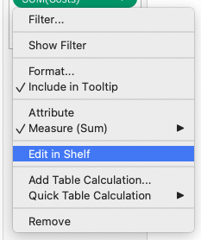
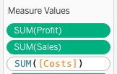
Calculations on the Shelf
You can do calculations
right in the Columns or Rows
shelf
You can also edit aggregate
measures in the Measures Value ‘shelf’

Slide 5

Errors on the Shelf
Tableau will tell you if
your calculation is valid or invalid

Slide 6
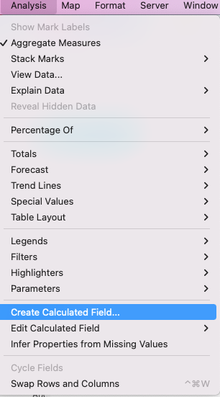
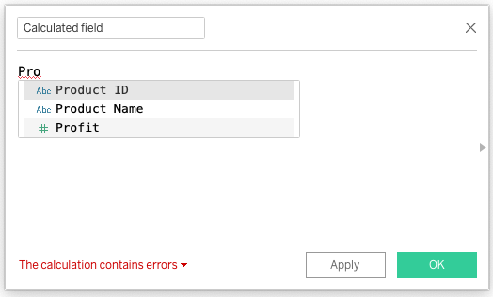
Calculated Fields

Slide 7
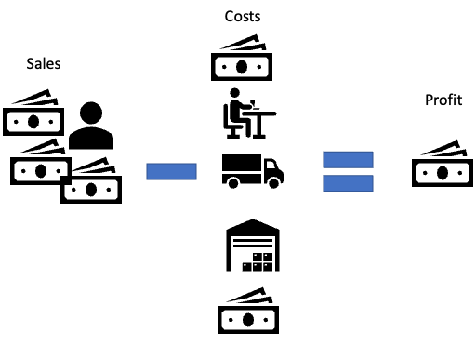
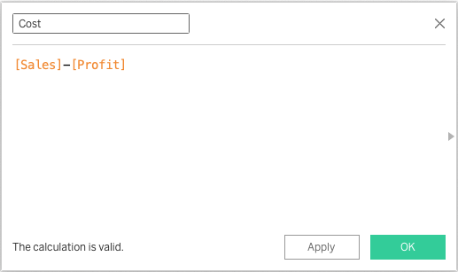
Calculated Fields - Costs

Slide 8
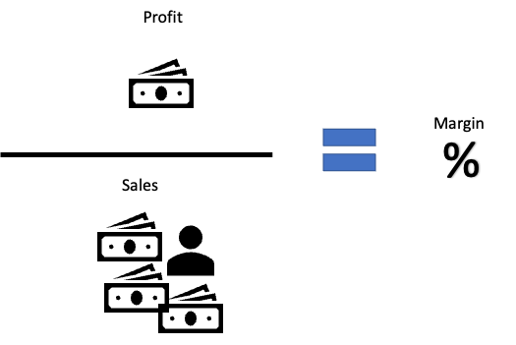
Calculated Fields - Margin

Slide 9
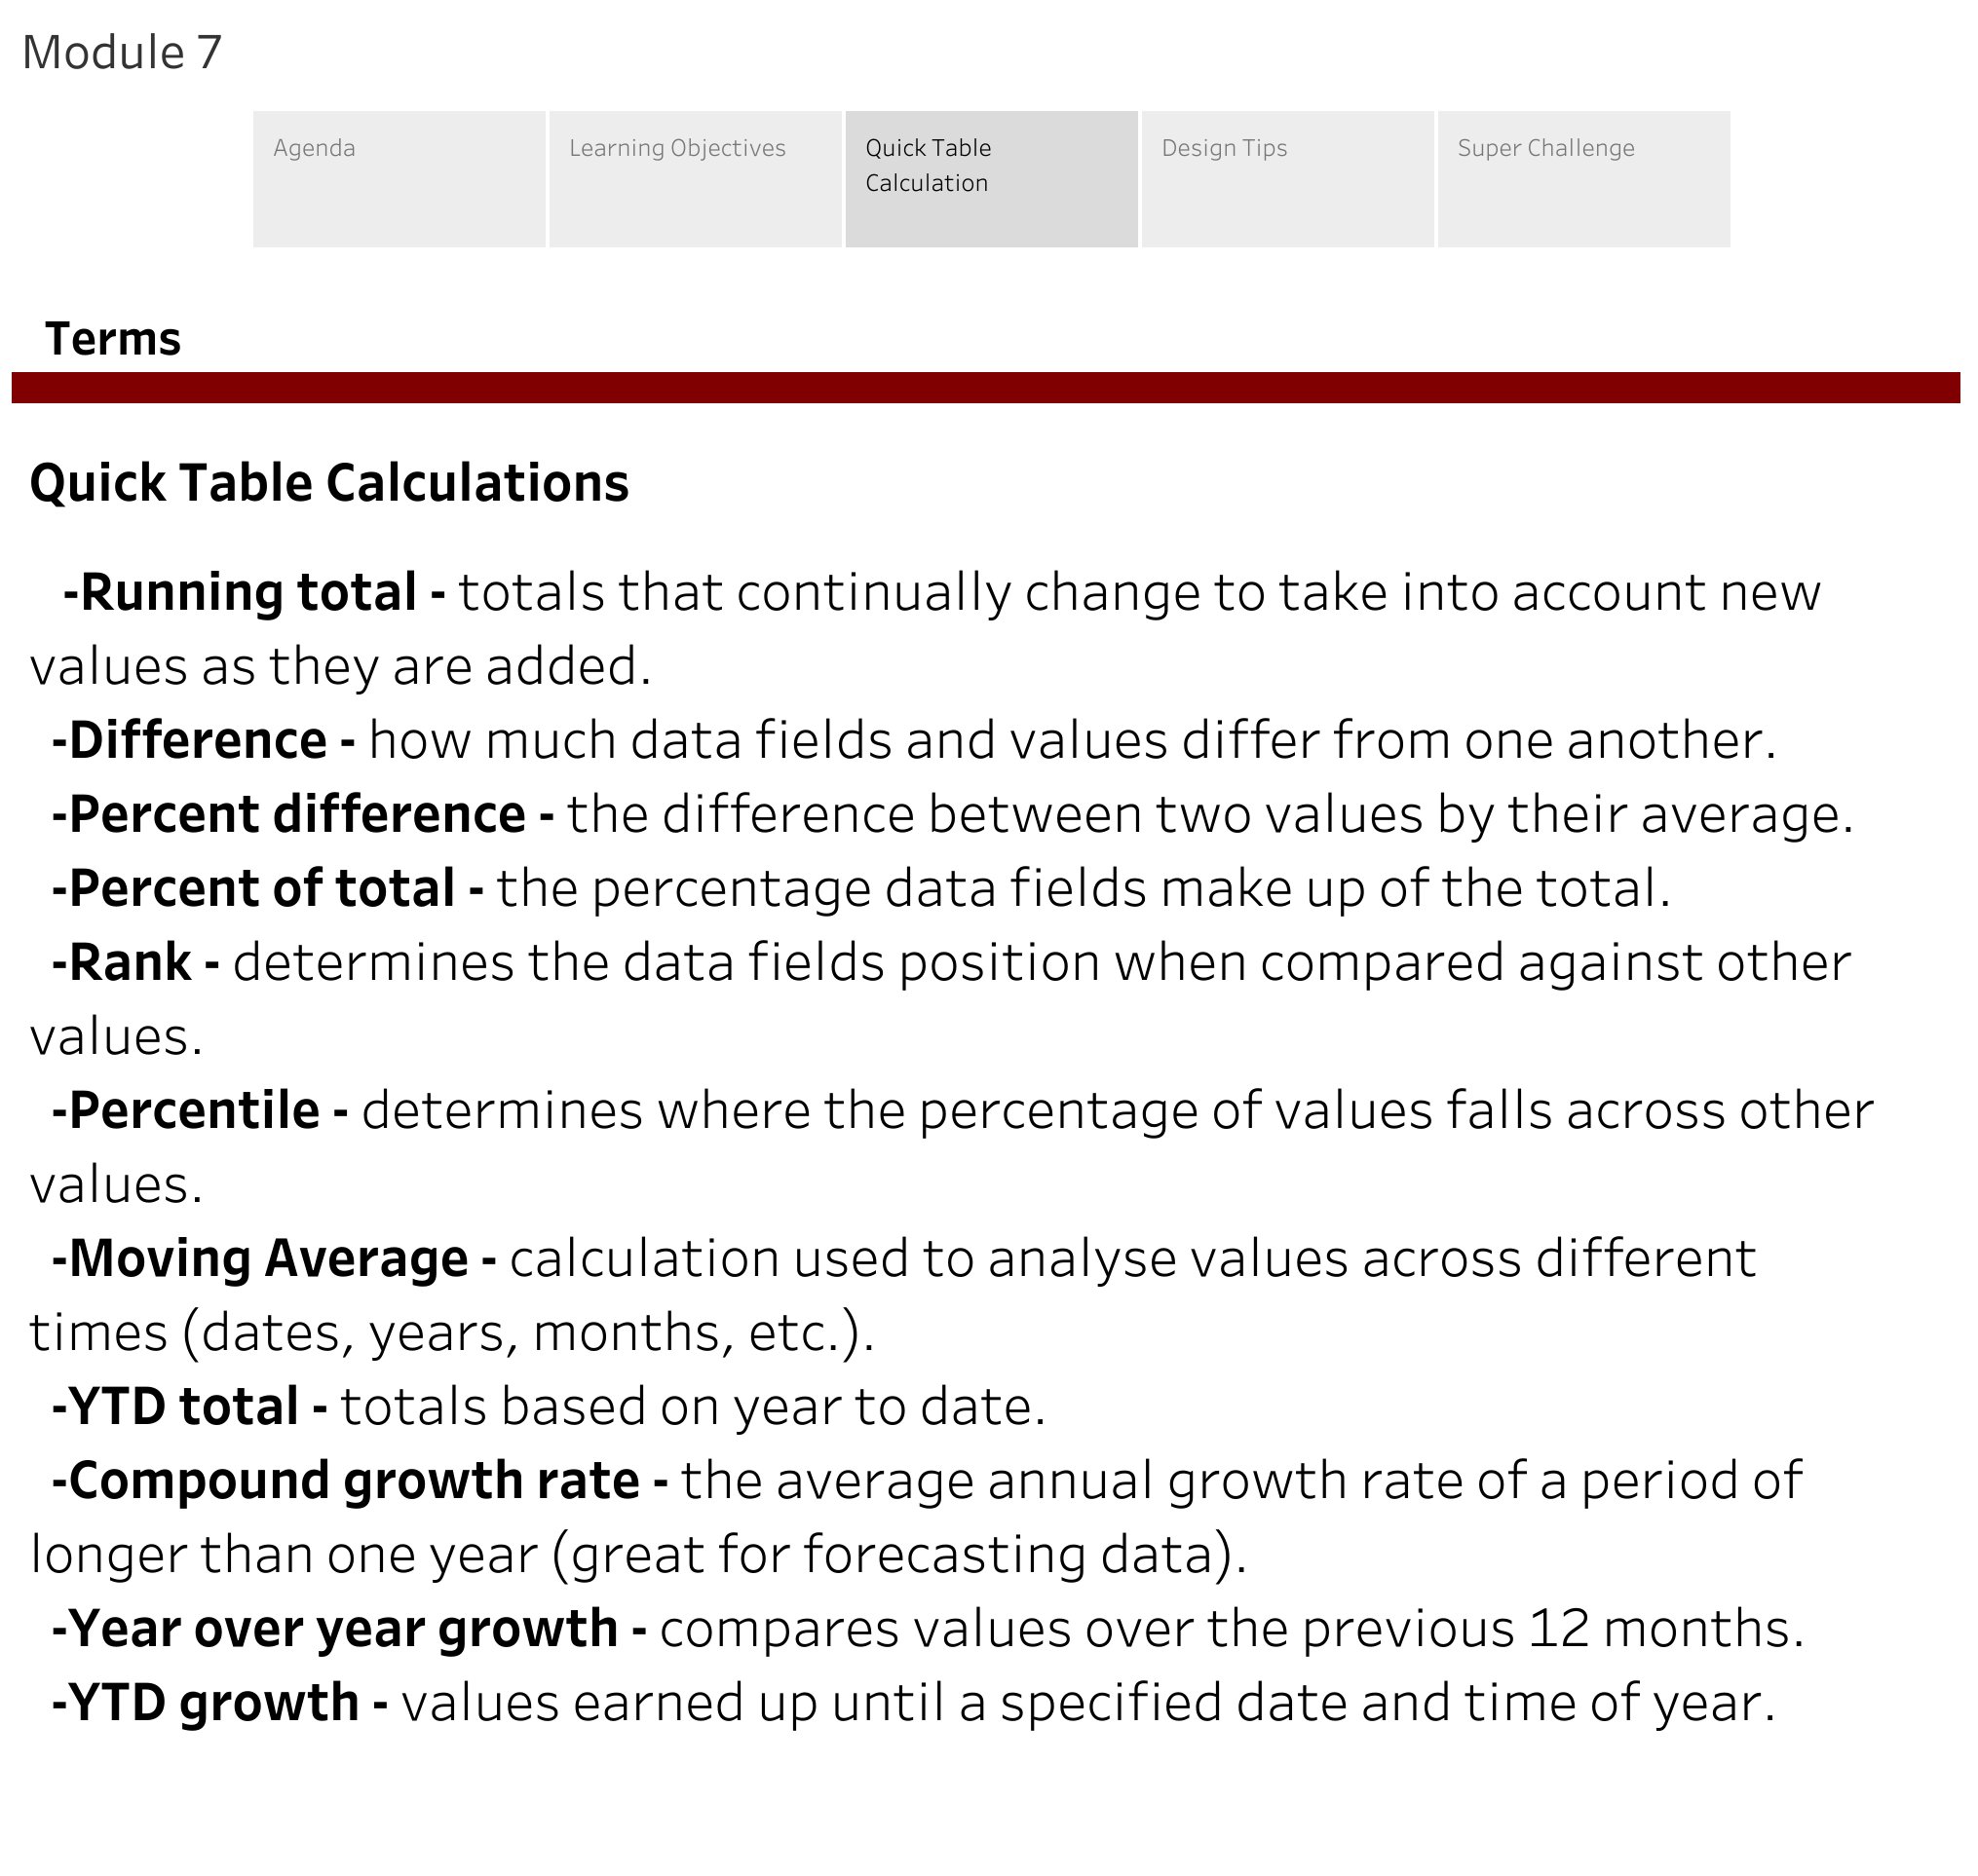
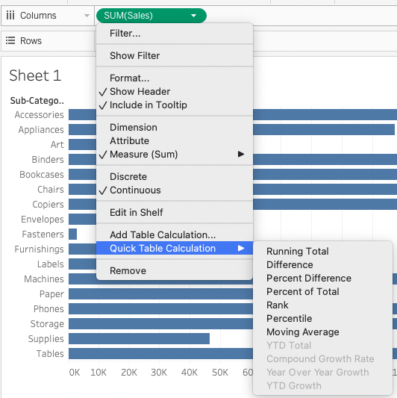
Quick Table Calculations

Slide 10
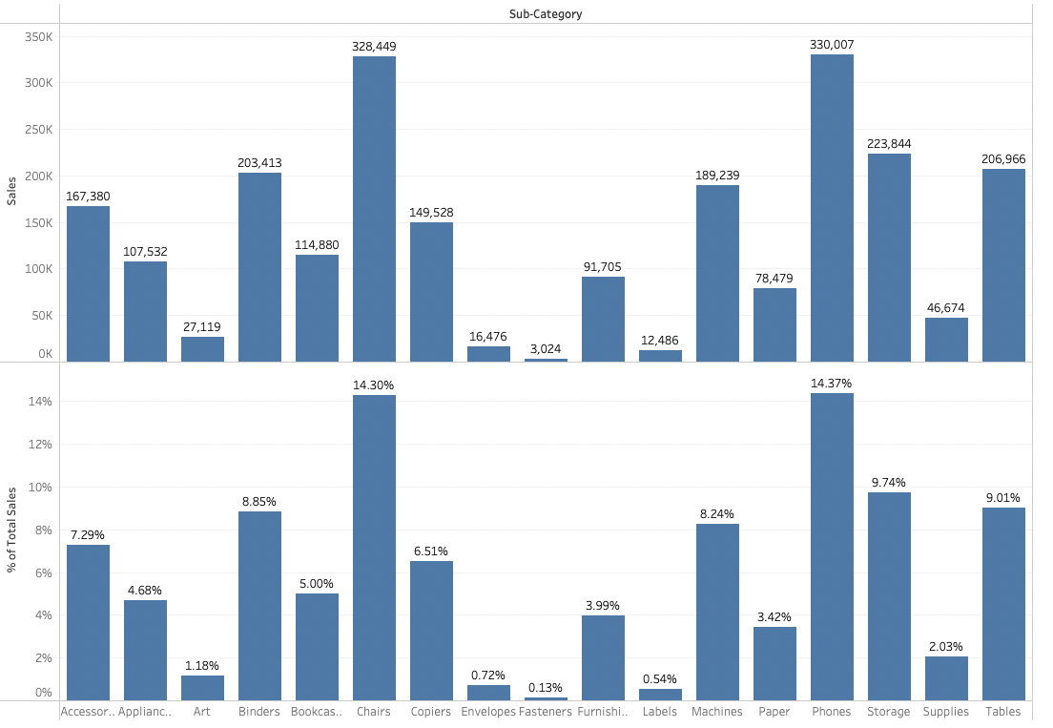
% of Total

Slide 11
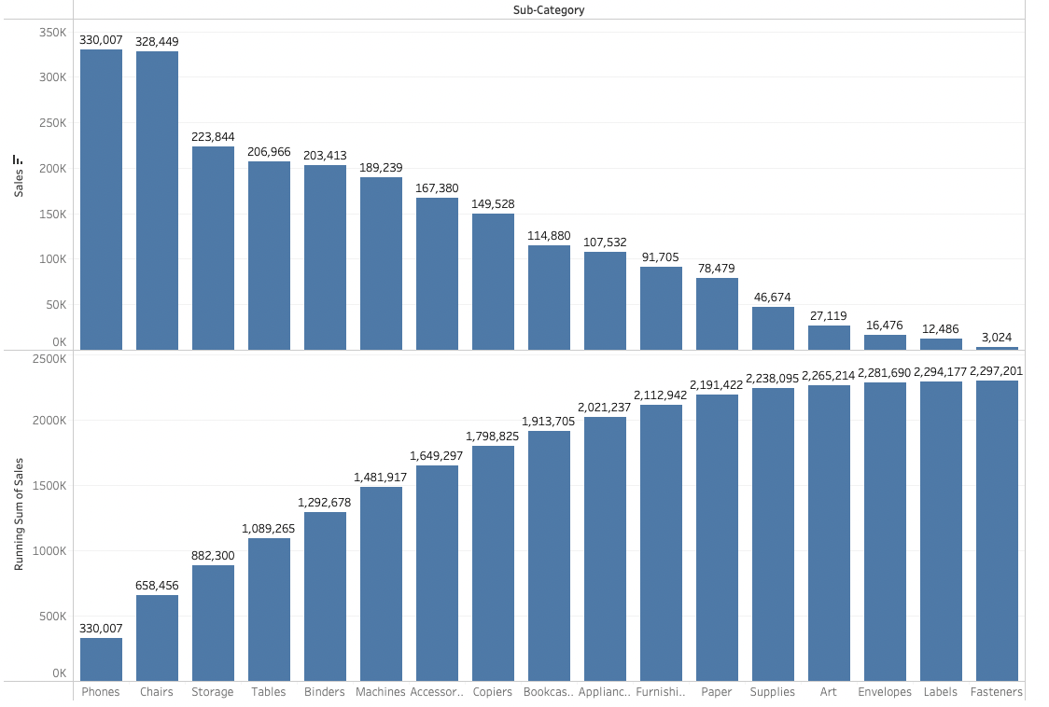
Running Total

Slide 12
Lunch

Slide 13
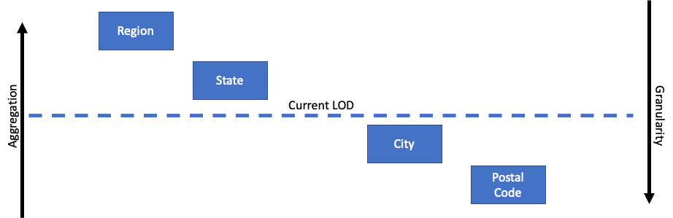
LOD Calculations

Slide 14
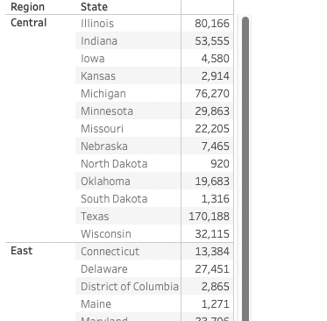
What Do We Want?
I want to add a column that shows me the sum of sales for
Region NO MATTER WHAT
Level of Detail I’m at

Slide 15
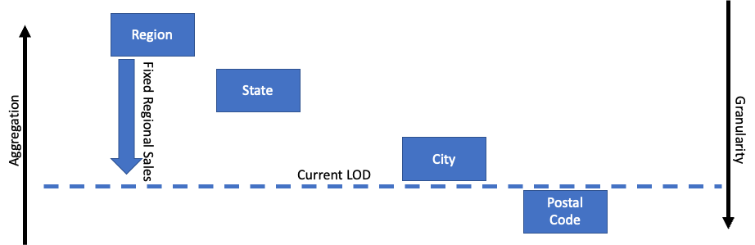
FIXED Calculations
No matter what level we drill into
I want a sum of sales at the regional
level to be available
{FIXED [Region]: SUM([Sales])}

Slide 16
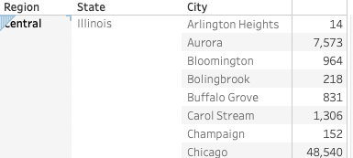
What Do We Want?
I want to add a column that shows me the total state sales without breaking down by city.

Slide 17
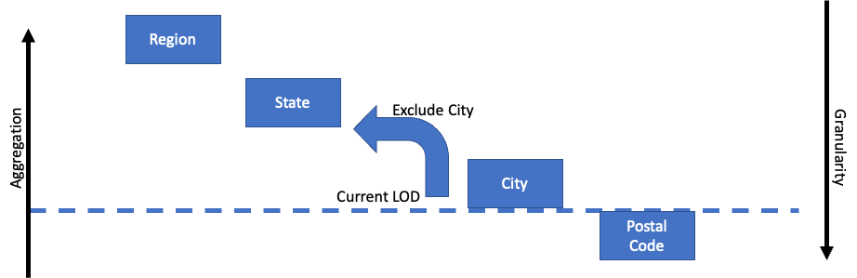
EXCLUDE Calculations
This tells Tableau that for this SUM we don’t want it broken down by City
{EXCLUDE [City]: SUM([Sales])}

Slide 18
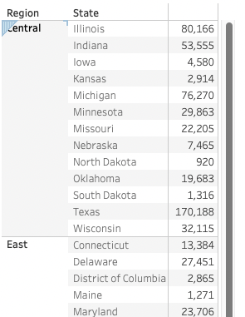
What Do We Want?
I want to add a column that shows me the max sales in any single city in this state

Slide 19
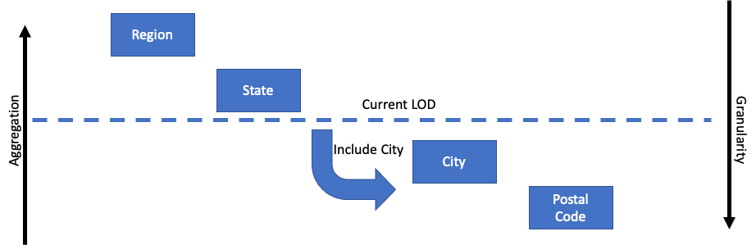
INCLUDE Calculations
This tells Tableau that for this
SUM you should include City sales so we can get the Max city
{INCLUDE [City]:SUM([Sales])}

Slide 20
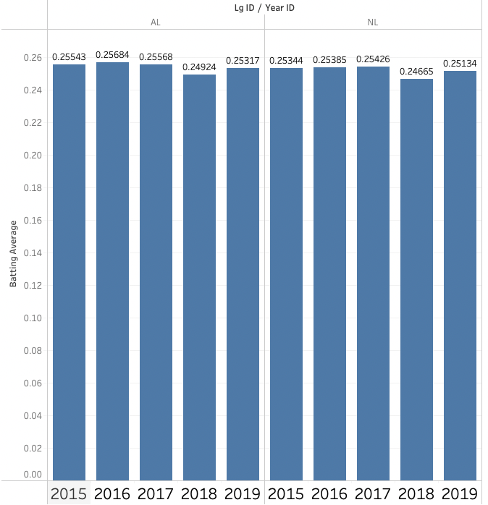
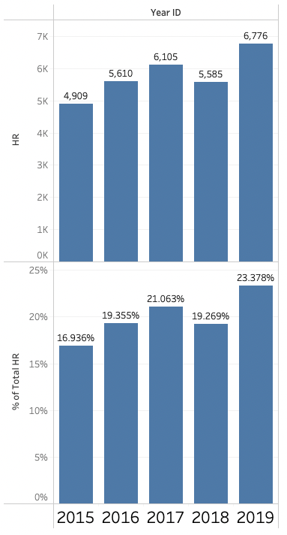
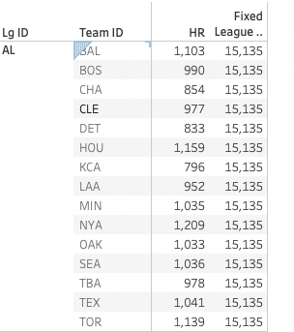
Module 7 Challenge
use baseball2015-2019.csv
1
Batting Average = hits divided by at-bats or H/AB
Create a calculated field for Batting Average that should work at the player, team, league, and year levels of aggregation. Create a bar chart that shows batting average by League and Year
Create a bar plot with the sum of Homeruns (HR) by year.
Split the plot so you have a duplicate (above and below) barplot
Change the barplot on the bottom to show % of total
3. Create a Fixed LOD calculation that always calculates the total number of Homeruns by league. Create a table that shows total Homeruns per team and league in one column, and the Total Homeruns per league in a second column.
3
2

